Slide 1
XHAW5112 | GROUP SIX
NEXT LEVEL GAMING ARENA
NEXT LEVEL
GAMING
ARENA
APP & WEBSITE
DEVELOPMENT
LETHABO MOHLALA
KEABETSWE MATHOLE
KEVIN SIAGA
01

Slide 2
XHAW5112 | GROUP SIX
NEXT LEVEL GAMING ARENA
The project at
a glance.
01
Positioning
Client needs, problem & proposed solution
02
Design Identity
From client needs to a consistent
brand and a connected user journey.
Concept, logo, colour & typography
03
Web & App Experience
Flows, wireframes & app screens
04
Website direction
Structure + demo explaination
02

Slide 3

XHAW5112 | GROUP SIX
NEXT LEVEL GAMING ARENA
Client-Based Focus.
CLIENT NEEDS
PROBLEM STATEMENT
SOLUTION
WHY THIS SCENARIO?
Our client, Jason Naidoo, needs a user-friendly website and mobile application where customers can explore gaming packages, view prices, discover events, select multiple services, calculate estimated costs (including 15% VAT), and submit their details to request a quotation.
Customers currently lack a convenient, centralized digital platform to explore the arena's offerings, compare packages and make informed booking enquiries. This makes accessing information and interacting with the business less convenient.
We proposed developing a responsive website and mobile application with simple navigation, clear service listings, package pricing, booking selections, automatic discount and VAT calculations, and a quotation request feature.
We selected Next Level Gaming Arena because it addresses a growing gaming and esports market in South Africa. It also provides an opportunity to combine creativity, technology and practical functionality while developing a solution that improves the customer experience and strengthens the business's online presence.
03

Slide 4
XHAW5112 | GROUP SIX
NEXT LEVEL GAMING ARENA
Colour With Purpose.
We selected this multi-tonal color palette to pair high-contrast dark bases with fiery warm and cool digital accents. This combination projects a high-energy, futuristic aesthetic tied to innovation while maintaining crisp readability across digital displays.
Blazing Flame
#FE492C
Ultraviolet
#7837FB
Sky Aqua
#00D8F5
French Blue
#1B3E88
Onyx
#0A0A0A
Alabaster Grey
#E9E9E9
04

Slide 5

XHAW5112 | GROUP SIX
NEXT LEVEL GAMING ARENA
Inter
A mark built
for the arena.
One typeface. Clear hierarchy.
THE NL SHIELD MONOGRAM
This typeface made the most sense to us because its clean, modern and highly legible. Weights and sizes create structure without competing with the content.
Of all the options, this design was selected for its integration of a protective shield with the letters "NL," effectively communicating strength, professionalism, and competitive drive.
Main headings
40 px / 800
Secondary headings — medium / bold
24 px / 500 or 700
Body text — readable, clear supporting information.
16 px / 300 or 400
Error and disclaimer text — essential context and guidance.
14 px / 300 or 400
05

Slide 6
XHAW5112 | GROUP SIX
NEXT LEVEL GAMING ARENA
Website Journey.
A direct route from discovery to booking request.
HEADER NAVIGATION
Home | Offers | Booking | FAQ | Contact
ONE SHARED LOGIC
THE DESKTOP LAYOUT CHANGES; THE CORE TASKS STAY FAMILIAR.
HOME
→
OFFERS
→
BOOKING
→
FEES
→
CONFIRMATION
Offer discovery
Booking request
Enquiry
Virtual Reality / Escape Room
Ultimate Gamer Pass / Esports Training
→ individual offer → booking
Select experiences → fill details
→ fees calculated
→ booking confirmed screen
Contact → “Got a question?”
→ complete enquiry form
→ send enquiry
06

Slide 7
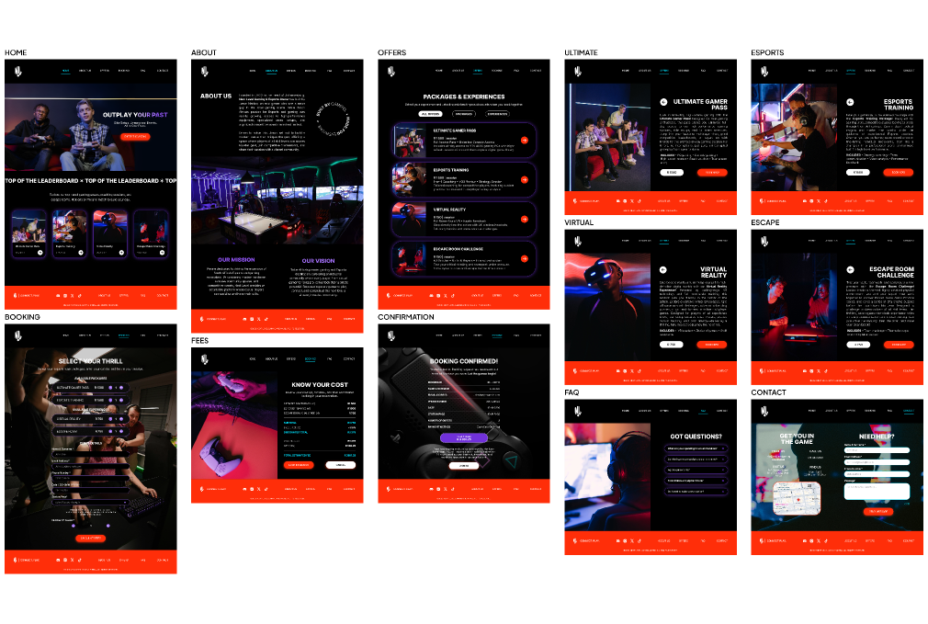
XHAW5112 | GROUP SIX
NEXT LEVEL GAMING ARENA
Structure
before
coding.
Designed for desktop screens, the wireframes feature a grid-aligned layout that maximizes horizontal space for content discovery. Key UI components include a persistent top navigation bar, split-screen image-and-text blocks, interactive maps, and expanded comparison tables. High-contrast orange action blocks paired with multi-column footers ground each page to deliver an expansive, multi-layered user experience.
07

Slide 8
XHAW5112 | GROUP SIX
NEXT LEVEL GAMING ARENA
App Journey.
A direct route from discovery to booking request.
BOTTOM NAVIGATION
Home | Offers | Booking | Contact
SLIDE-IN MENU
Menu open → About us / FAQ → Menu close
HOME
→
OFFERS
→
BOOKING
→
FEES
→
CONFIRMATION
Offers route
Booking route
Contact route
Offers → select package / experience
→ individual offer → booking
Select services → fill out details
→ fees calculated → booking confirmed
Contact → “Got a question?”
→ enquiry form → send enquiry
08

Slide 9
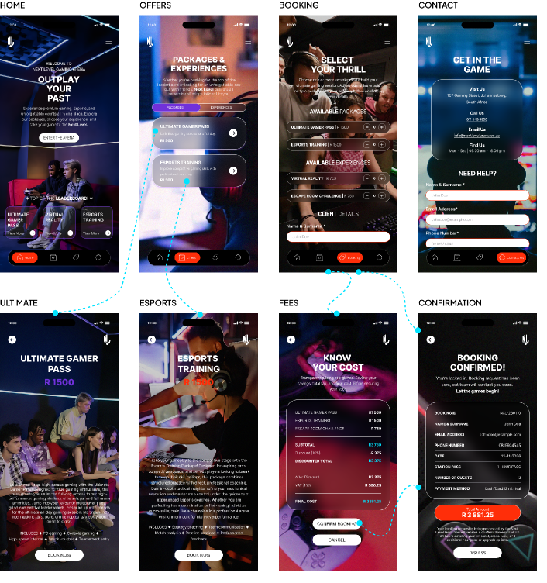
XHAW5112 | GROUP SIX
NEXT LEVEL GAMING ARENA
Structure before coding.
Before moving to code, we expanded our wireframes with dotted line linkage to clearly define the app's screen navigation routes. The design features a bold dark-mode aesthetic with high-visibility orange accents, clean typography, and structured content layouts that guide users intuitively from exploration through to booking and payment completion.
09

Slide 10
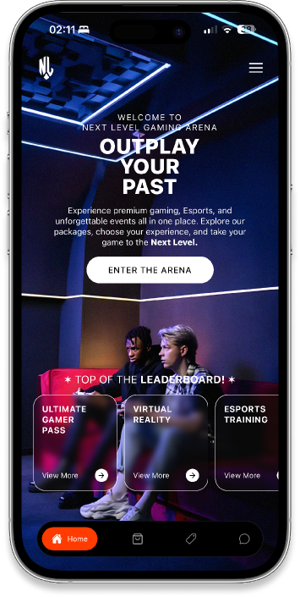
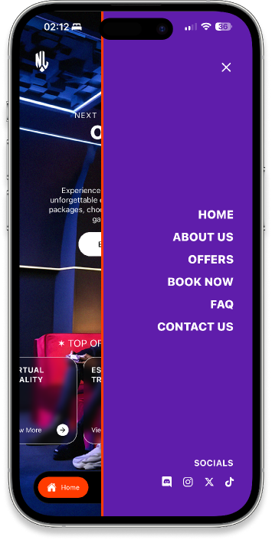
XHAW5112 | GROUP SIX
NEXT LEVEL GAMING ARENA
Home &
Slide menu.
The Home screen serves as the high-impact landing page to engage users immediately, while the Slide Menu acts as the global slide-in navigation overlay, enabling seamless transitions from Home to all main app routes and social links.
10

Slide 11
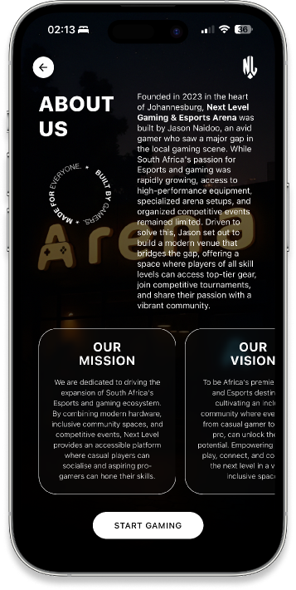
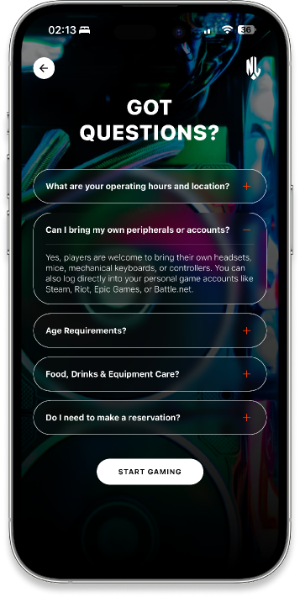
XHAW5112 | GROUP SIX
NEXT LEVEL GAMING ARENA
About &
FAQ.
Accessed directly through the slide menu, About Us establishes community trust by sharing the arena’s origin story and mission, while the FAQ screen supports user confidence by providing clear answers regarding operating hours, venue policies, age limits, and equipment rules.
11

Slide 12
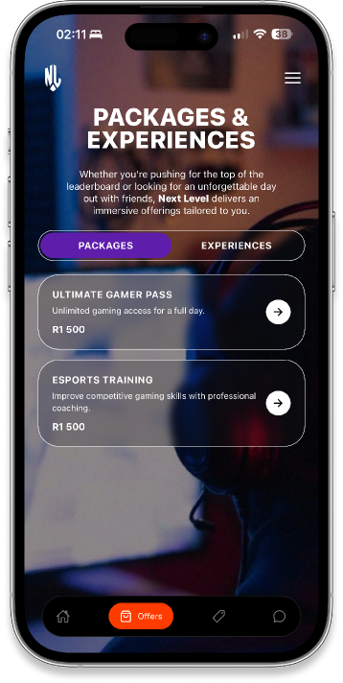
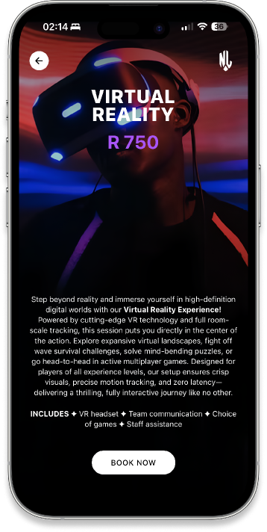
XHAW5112 | GROUP SIX
NEXT LEVEL GAMING ARENA
Offers &
Individual.
The Offers screen acts as the primary showcase catalog where users browse and toggle between experience options, while the Individual sub-page dives deeper into a single selected package to outline specific inclusions and itemized pricing with a direct pathway into the booking flow.
VIEW OPTIONS
→
READ MORE
12

Slide 13
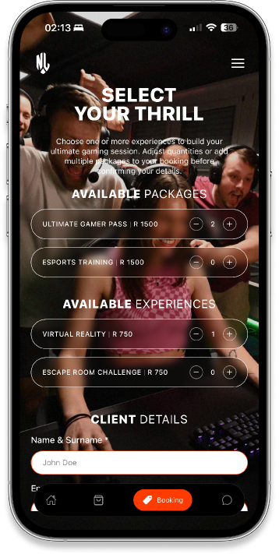
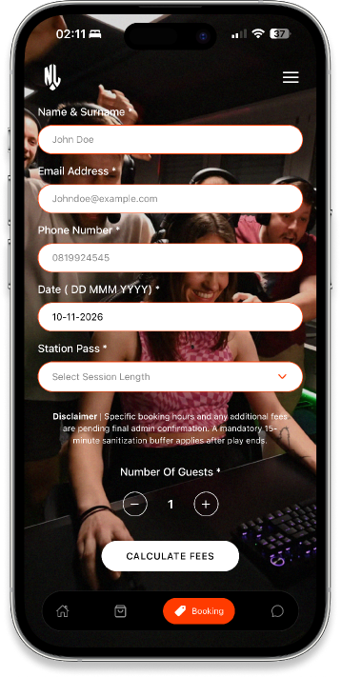
XHAW5112 | GROUP SIX
NEXT LEVEL GAMING ARENA
Booking
Process.
The Booking screen serves as the entry point for configuring an experience, allowing users to select packages, specify guest counts, enter client details, and initialize the downstream financial calculations.
SELECT OFFER
→
FILL IN DETAILS
13

Slide 14
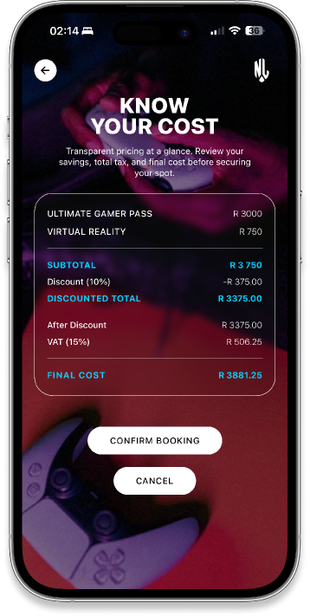
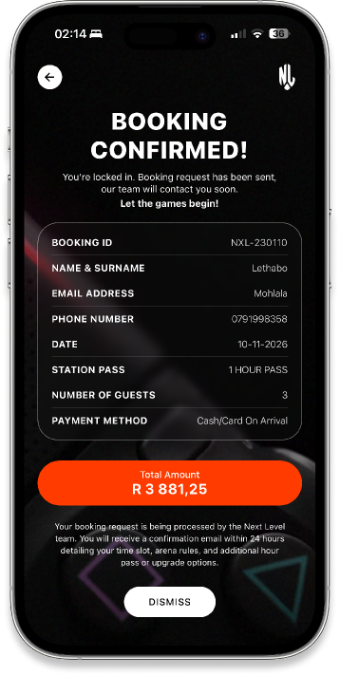
XHAW5112 | GROUP SIX
NEXT LEVEL GAMING ARENA
Fees &
Confirmation.
Functioning as a sequential checkout pipeline, the Fees screen dynamically calculates itemized sub-totals, tier discounts, and VAT, which then passes into the Confirmation screen to display the finalized invoice, booking verification ID, and completion information.
FEE CALCULATES
→
CONFIRM
14

Slide 15
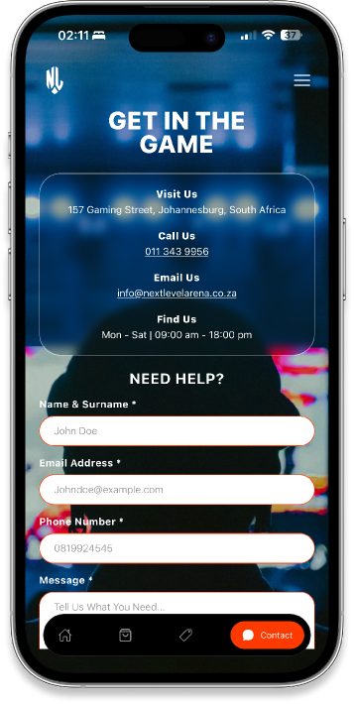
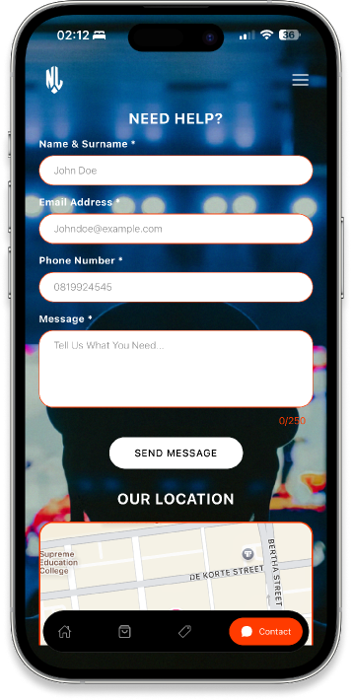
XHAW5112 | GROUP SIX
NEXT LEVEL GAMING ARENA
Contact
Us.
The Contact screen provides essential venue communication tools, allowing users to locate the physical arena via an interactive map, view direct contact details, and send inquiries through an integrated message form.
FILL IN ENQUIRY
→
SEND IT OUT
15

Slide 16
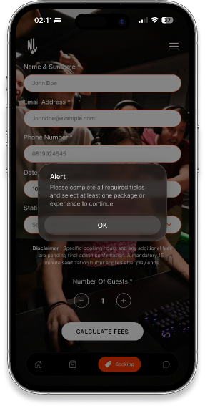
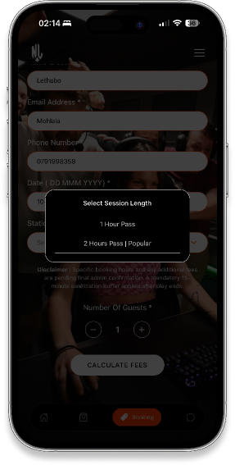
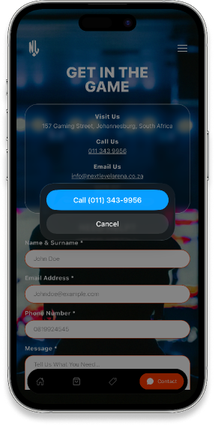
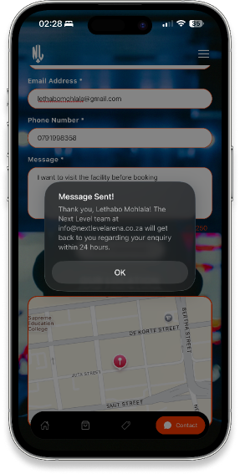
XHAW5112 | GROUP SIX
NEXT LEVEL GAMING ARENA
Validations.
FORM VALIDATION
SESSION SELECTION
CONTACT ACTION
ENQUIRY FEEDBACK
16

Slide 17
XHAW5112 | GROUP SIX
NEXT LEVEL GAMING ARENA
Now for the live demo of the website.
17

Slide 18

XHAW5112 | GROUP SIX
NEXT LEVEL GAMING ARENA
17

